Slide 1
filter() in Python
DVT101 – Lecture 20
- By Dataverse Tutorials

Slide 2
Introduction
What is filter() in Python
Why filtering data is important
Real-life analogy of filtering
Where filter() is used in programming

Slide 3
What is filter() ?
filter() is a higher-order function
Works on iterable elements
Keeps elements where condition is True
Returns a filter object (iterator)

Slide 4
Syntax & Internal Working
Syntax: filter(function, iterable)
Function returns True / False
Lazy evaluation (iterator)
Convert to list, tuple, set

Slide 5
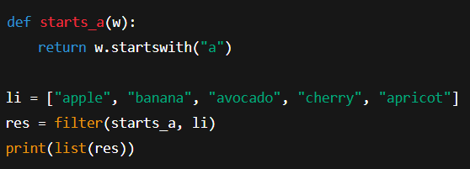
Basic Example (Words starting with “a”)
Custom condition function
filter() applies condition
Extract matching strings

Slide 6
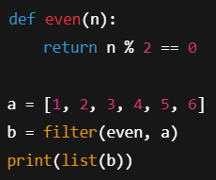
filter() with Named Function (Even Numbers)
Use filter with user-defined function
Logical condition inside function
Extract even numbers

Slide 7
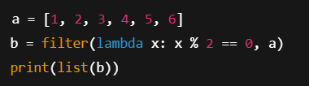
filter() with Lambda Function
No need for separate function
Inline condition using lambda
Clean and compact code

Slide 8
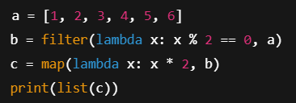
filter() + map() (Pipeline Example)
First filter data
Then transform data
Functional programming pipeline

Slide 9
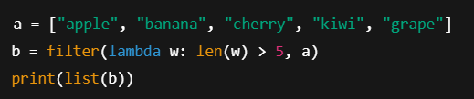
Filtering Strings by Length
filter strings based on length
lambda with len()
Text processing example

Slide 10
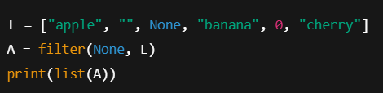
filter(None, iterable)
Remove falsy values
Truthy vs falsy concept
No custom function required

Slide 11
Real-World & Industry Use Cases
Data cleaning
ML preprocessing
Log filtering
API response handling

Slide 12
Summary & Key Takeaways
filter() selects elements conditionally
Returns iterator
Best with lambda
Use with map for pipelines

Slide 13


